Slide 1

Geospatial Chart Types

Slide 2
Choropleths
Notes:
When to use choropleths: when the enumeration unit actually matters

Slide 3
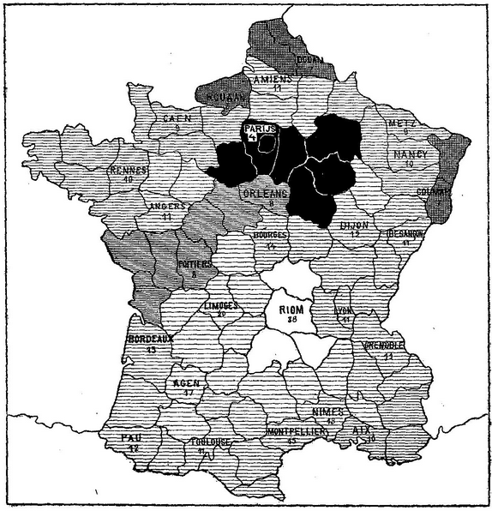

Slide 4
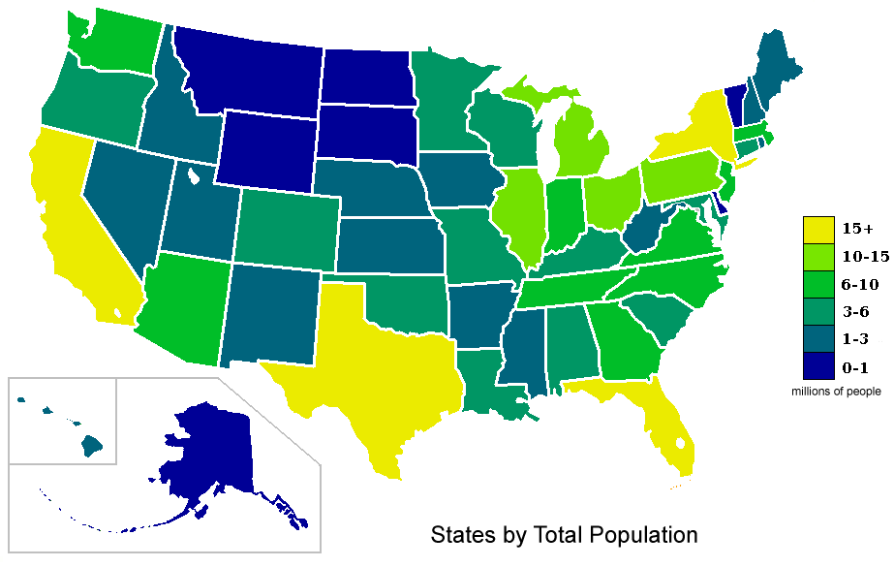
http://upload.wikimedia.org/wikipedia/commons/4/48/USA_states_population_map_2007_color.png

Slide 5
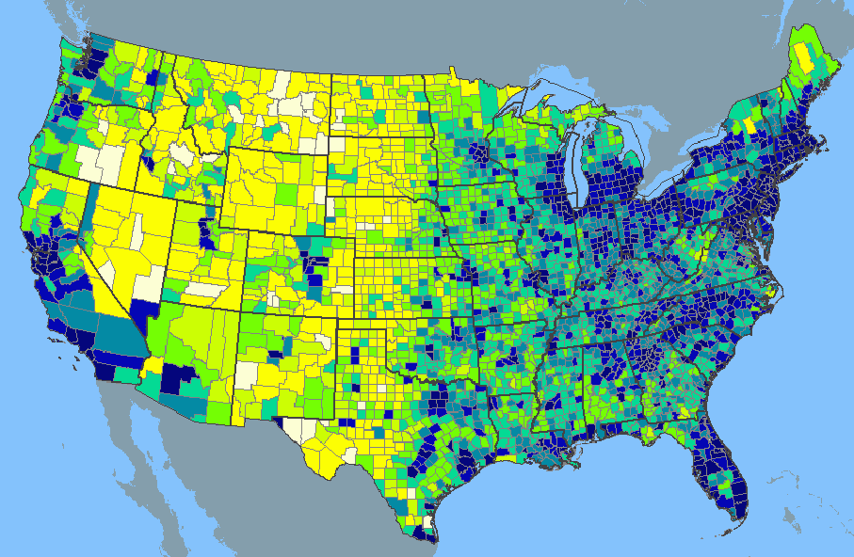
http://www.learnnc.org/lp/media/uploads/2010/02/usa-2000-population-density.gif

Slide 6
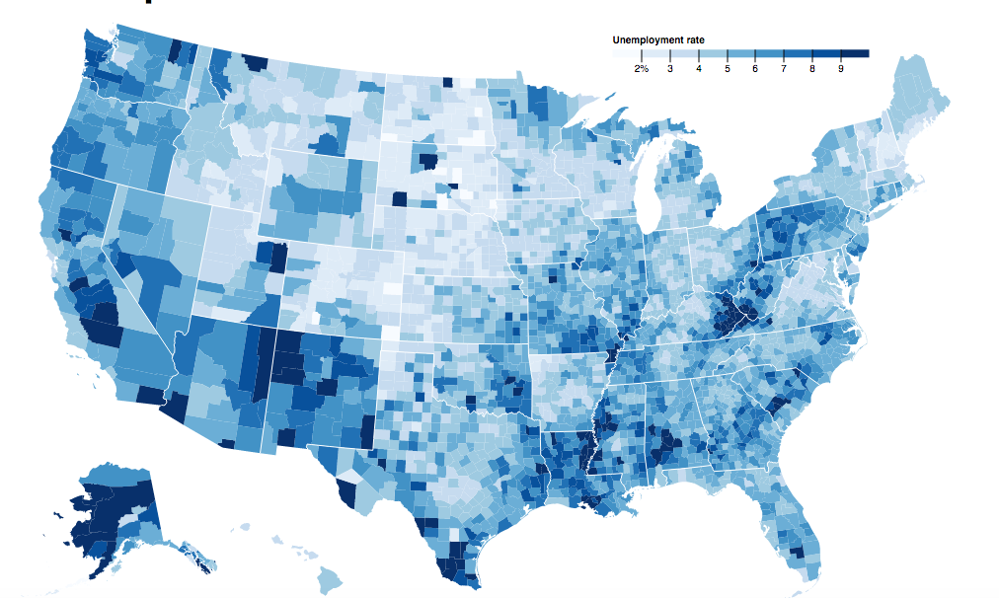
https://bl.ocks.org/mbostock/4060606

Slide 7
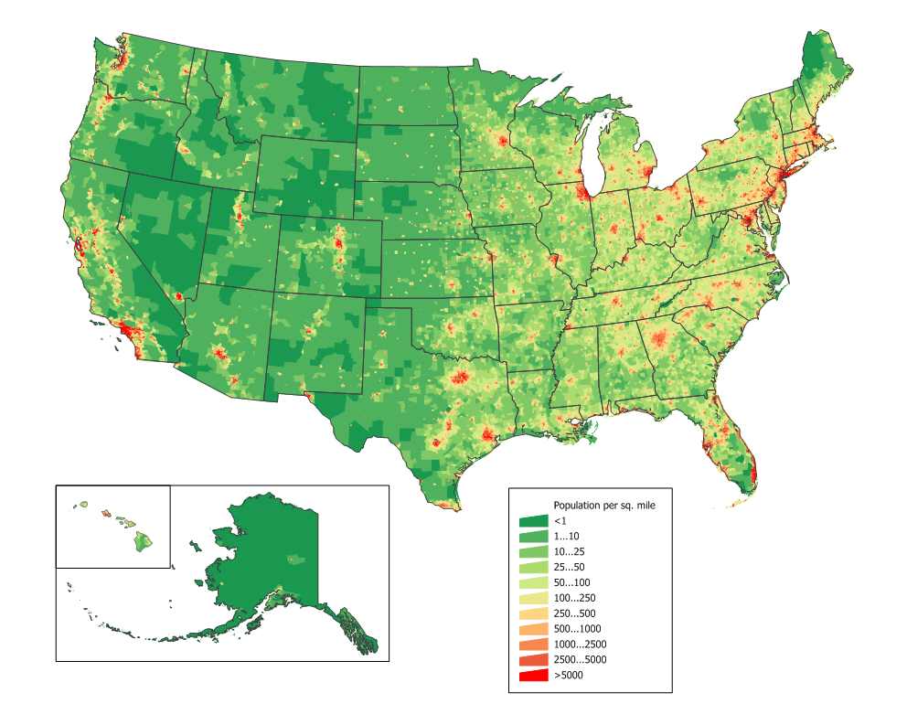
ZIP/Census Track Level and Shown as Ratio
http://upload.wikimedia.org/wikipedia/commons/2/21/US_population_map.png

Slide 8
Proportional & Graduated Symbol Maps

Slide 9
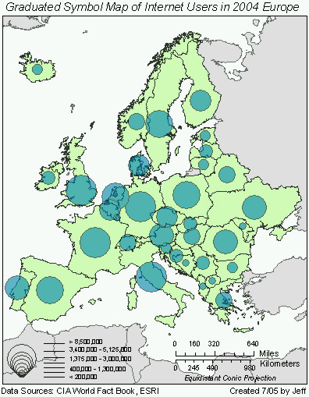
http://www.geog.ucsb.edu/~jeff/gis/proportional_symbols_files/map1.jpg

Slide 10
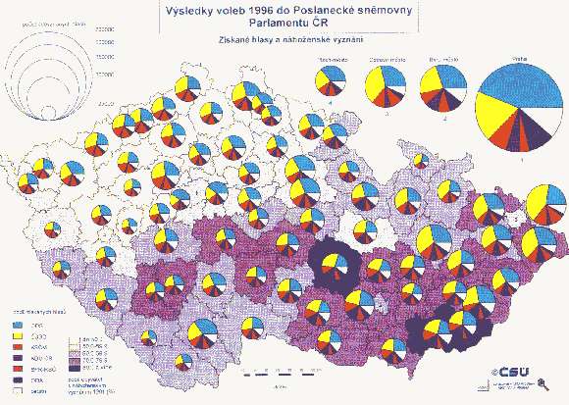
http://geographyfieldwork.com/DataPresentationMappingTechniques.htm

Slide 11
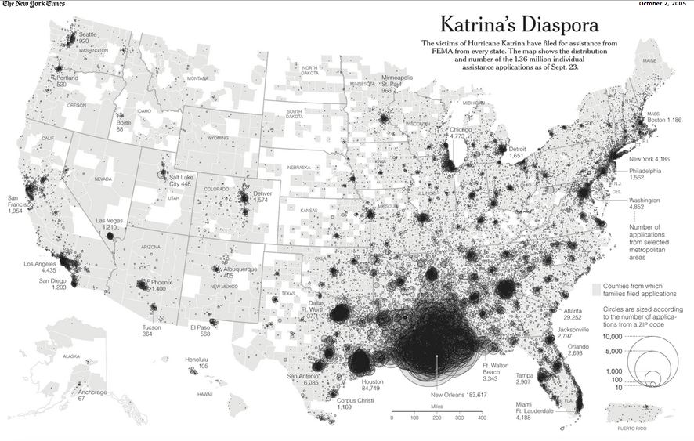
http://www.nytimes.com/imagepages/2005/10/02/national/nationalspecial/20051002diaspora_graphic.html

Slide 12

Image Source: https://blogs.scientificamerican.com
Notes:
Ebbinghaus Illusion two identical circles look different sizes depending on the size of the symbols around them.
https://blogs.scientificamerican.com/not-bad-science/an-optical-illusion-as-seen-by-a-fish/

Slide 13
Isopleth Maps

Slide 14
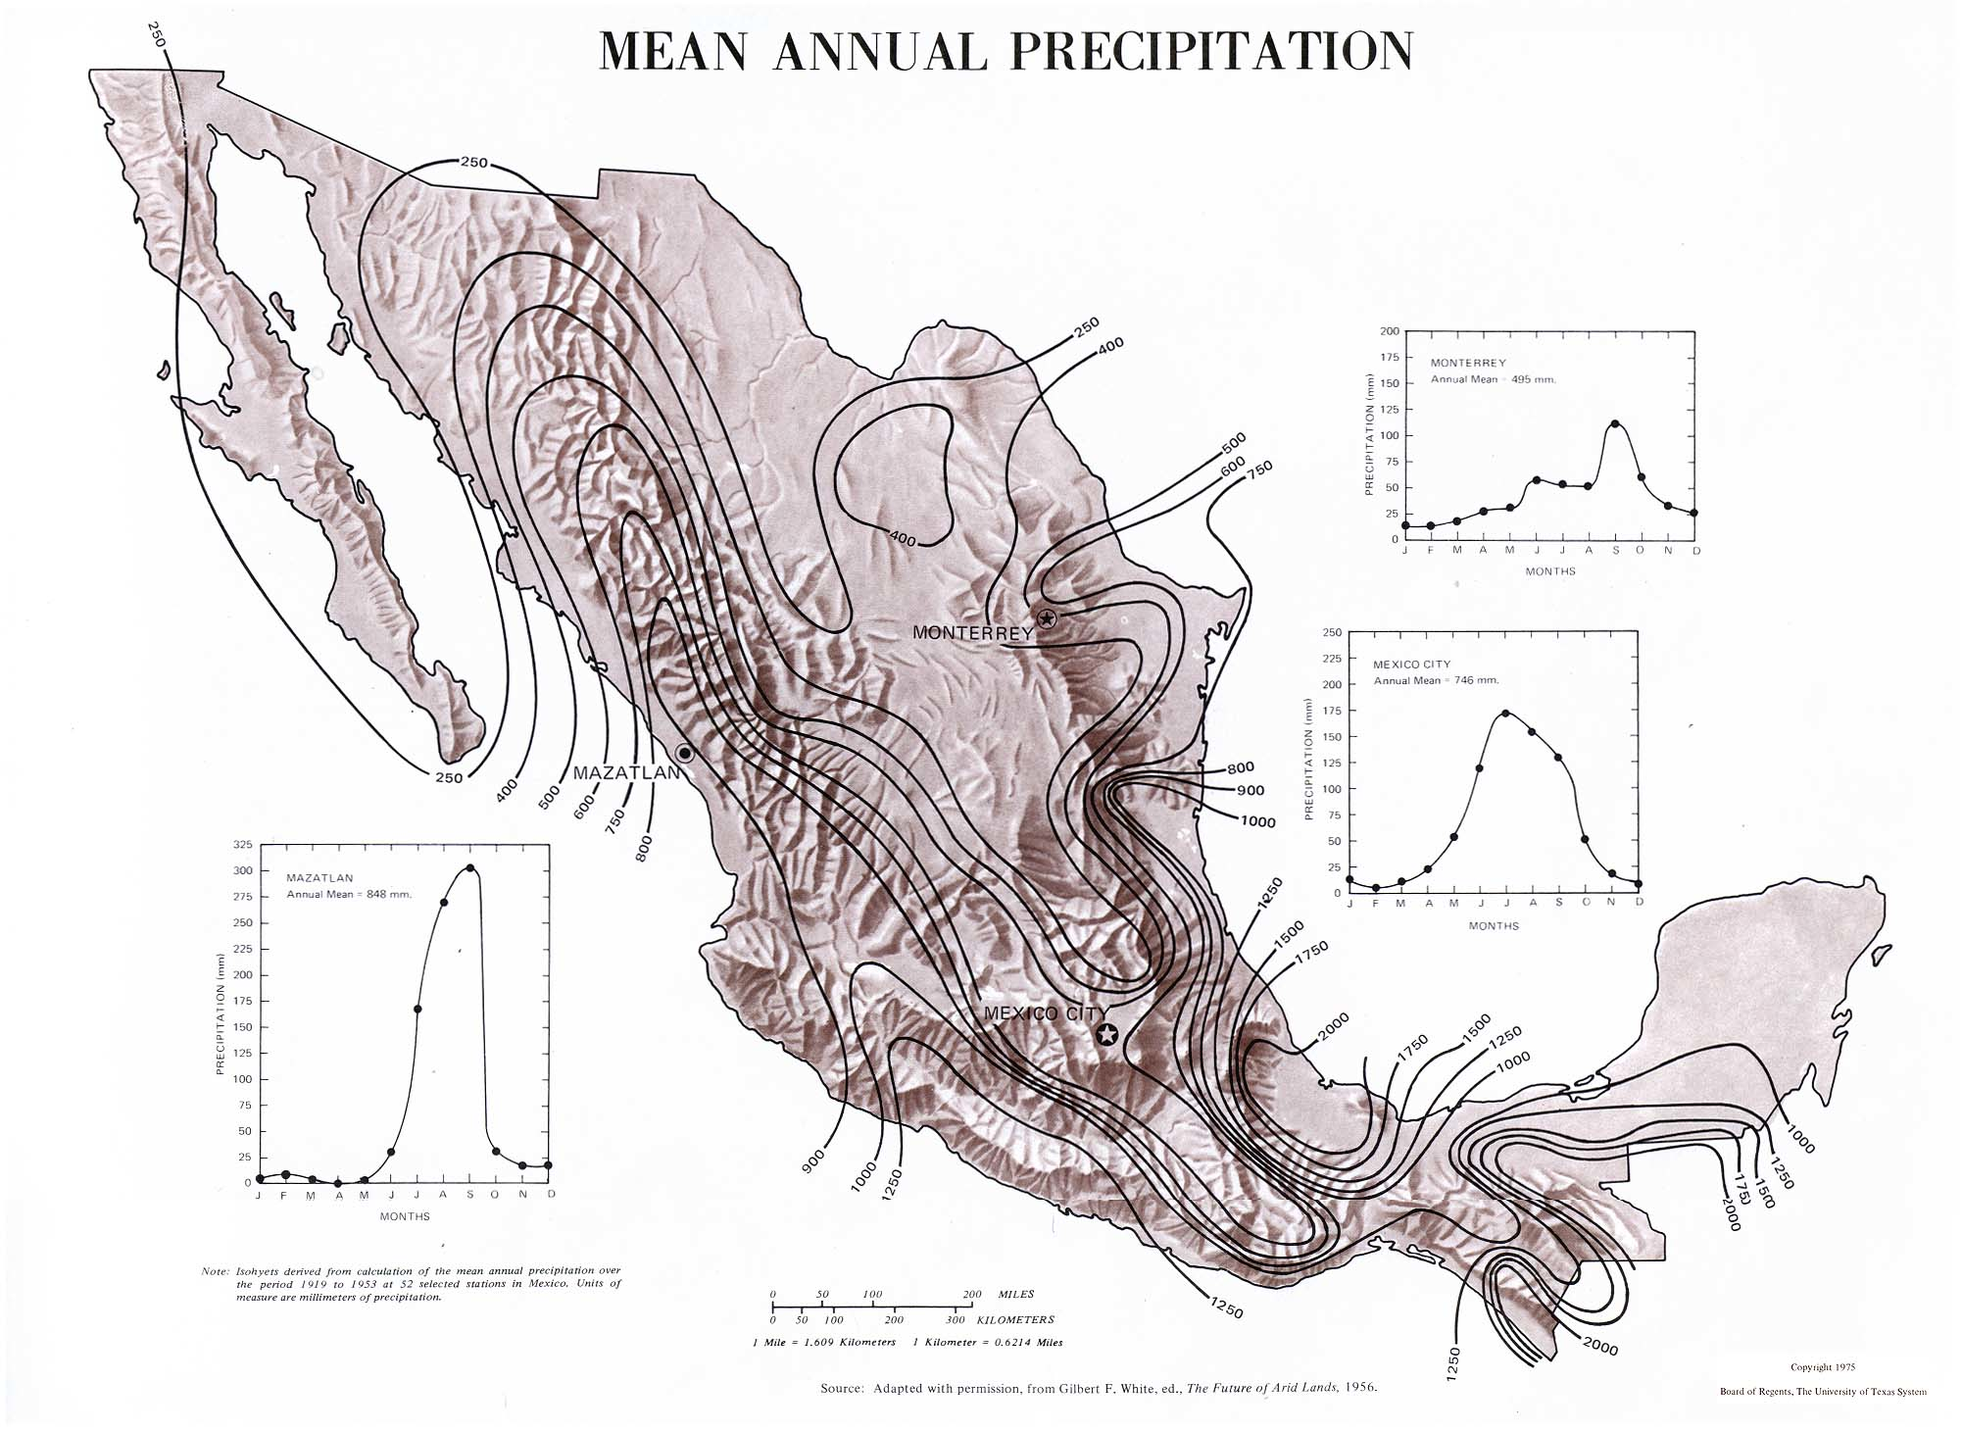
http://www.lib.utexas.edu/maps/atlas_mexico/mean_annual_precipitaion.jpg
Notes:
Two dimensional representation of 3 dimensional data, continuous lines not interrupted by artificial boundaries

Slide 15
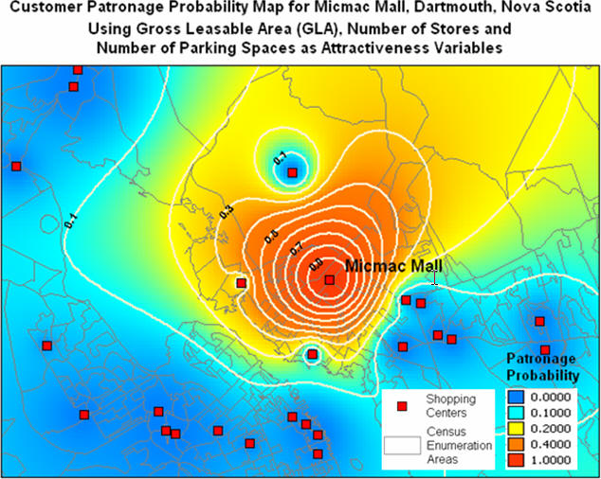
http://www.directionsmag.com/images/newsletter/2005/06_29/Figure2_lg.jpg

Slide 16
Dots

Slide 17
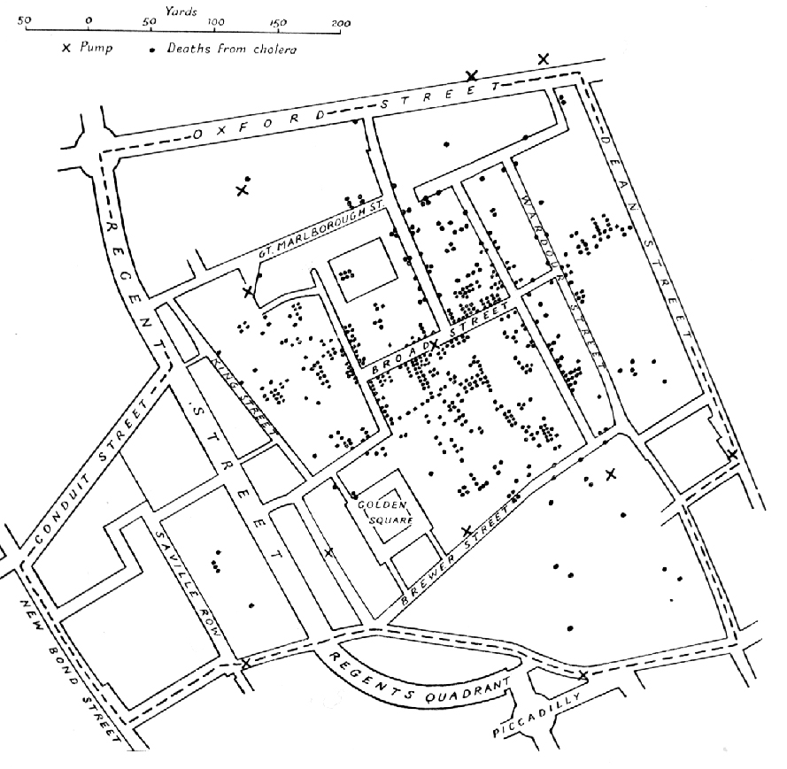

Slide 18
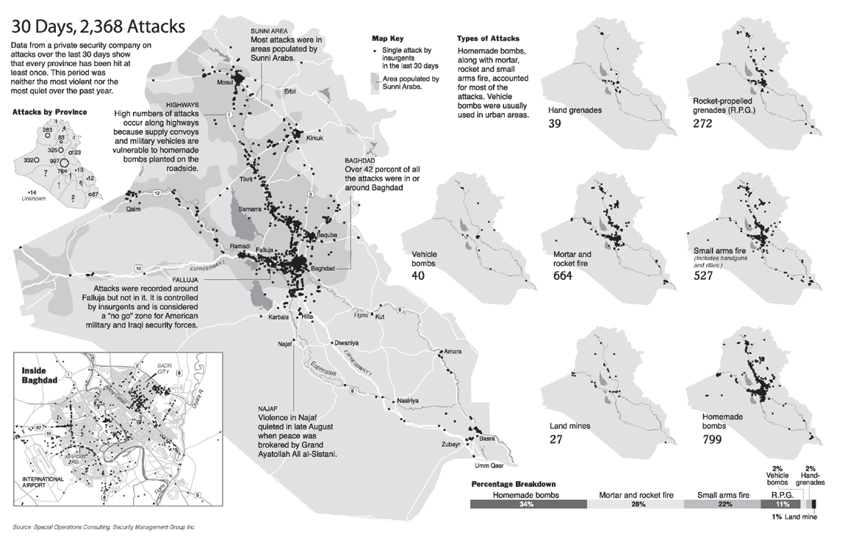

Slide 19
Generalized

Slide 20

http://dctransitguide.com/static/images/WMATA_system_map.png

Slide 21
Cartogram

Slide 22
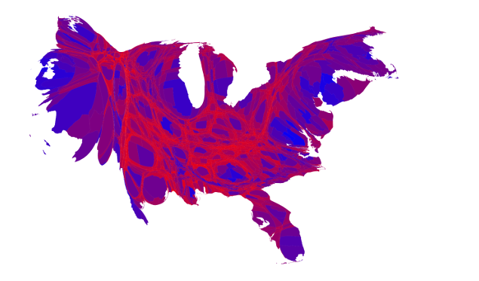
Source: http://www-personal.umich.edu/~mejn/election/2016/

Slide 23
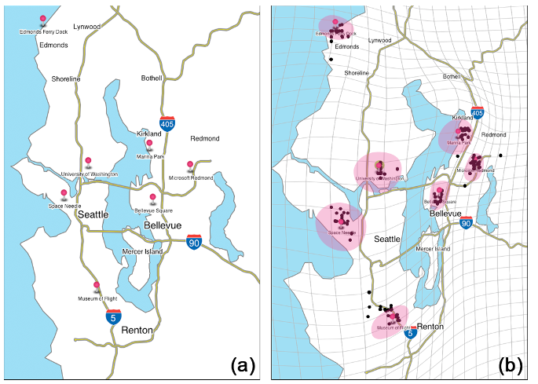
Hong et al., 2014. Traffigram: Distortion for clarification via isochronal cartography.

Slide 24
Other Types

Slide 25
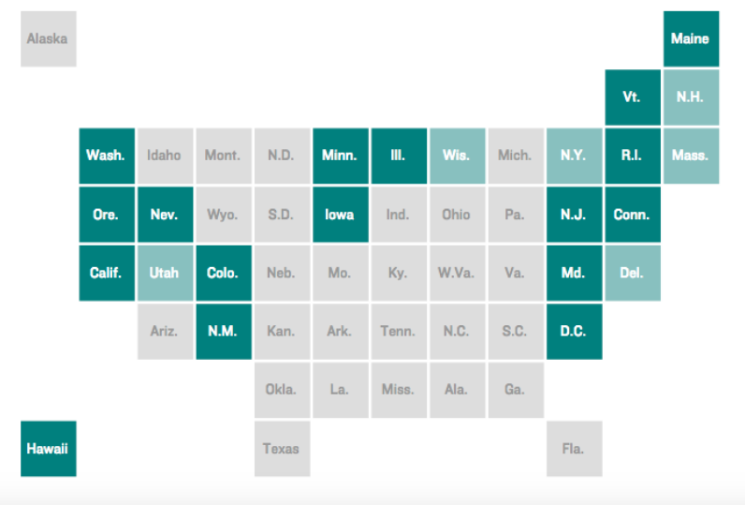
Source: http://blog.apps.npr.org/2015/05/11/hex-tile-maps.html
Notes:
Square tile map - Takes advantage of knowing the placement of states or geographic features. Add label at top of slide.
Some of the problems – such as north and south carolina are next to each other.

Slide 26
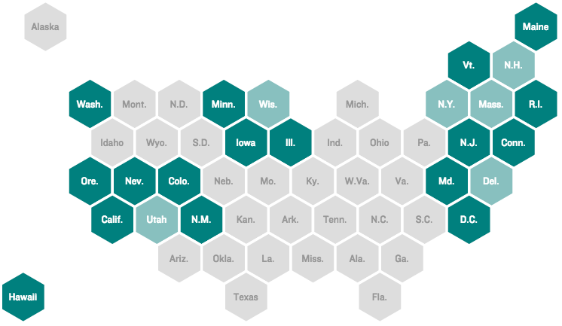
Source: http://blog.apps.npr.org/2015/05/11/hex-tile-maps.html
Notes:
Tile grid map. Squares, hexagons or other symbols.
http://blog.apps.npr.org/2015/05/11/hex-tile-maps.html

Slide 27
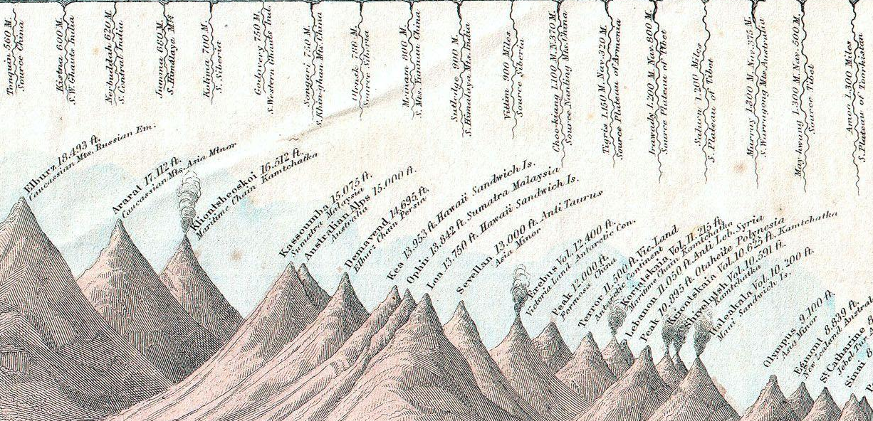
https://upload.wikimedia.org/wikipedia/commons/0/0f/1864_Johnson%27s_World_Mountains_and_Rivers_Map_or_Chart_-_Geographicus_-_MtsRvrs-johnson-1864.jpg

Slide 28
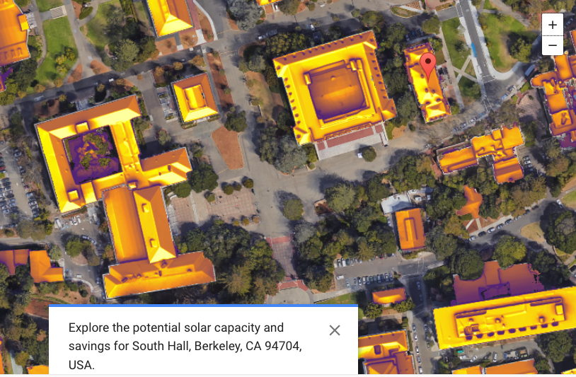
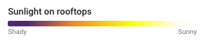
https://www.google.com/get/sunroof/

Slide 29
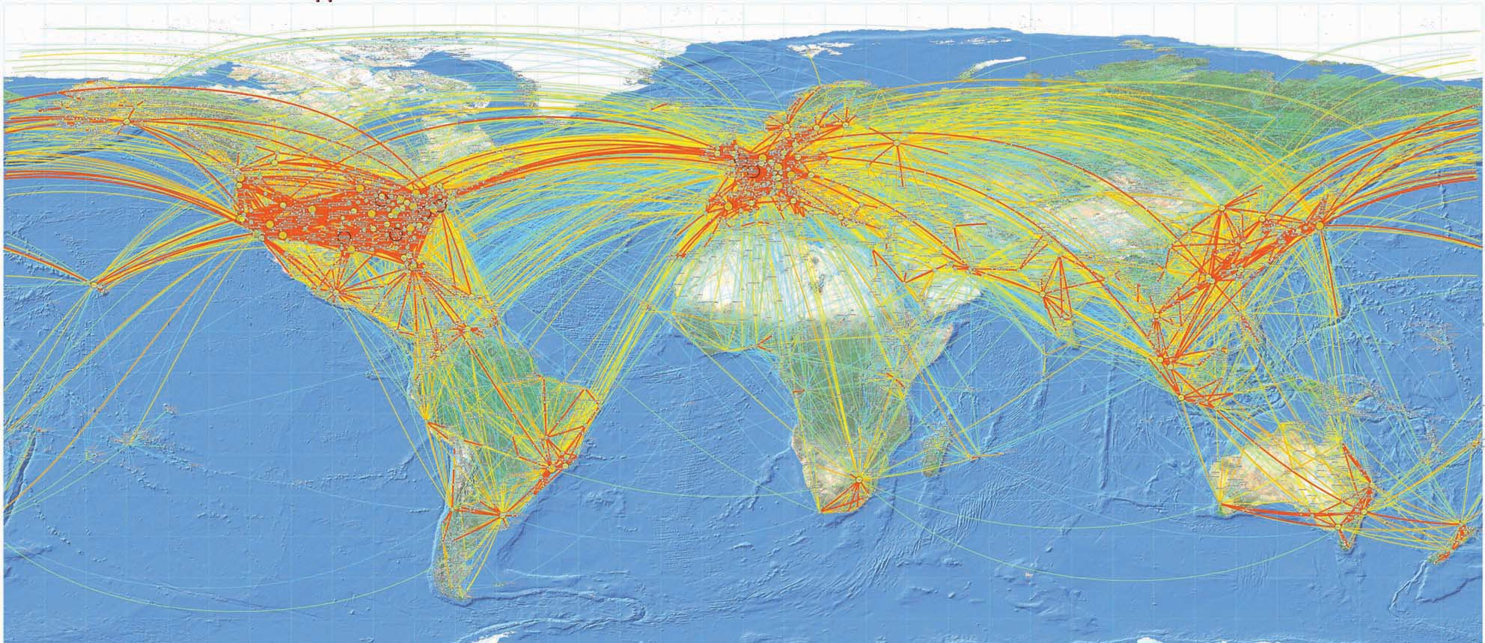
http://media.aerosociety.com/aerospace-insight/files/2012/01/World-traffic-flows-ICAO.jpg

Slide 30
Tools and Libraries

Slide 31
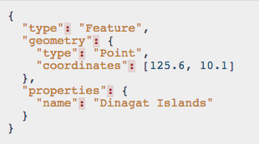
GeoJSON http://www.geojson.org

Slide 32
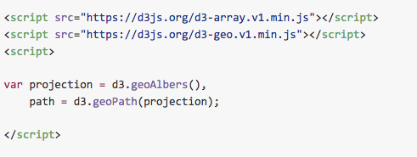
D3.geo https://github.com/d3/d3-geo

Slide 33
Tools and Libraries
Leaflet: http://leafletjs.com/
MapBox: https://www.mapbox.com/
PostGIS: http://www.postgis.net/
Mapnik: http://mapnik.org/

Slide 34


